Slide 1


IoT based smart house door Access system Enhancing home security Done by: SELMA VELIKOSHI

Slide 2
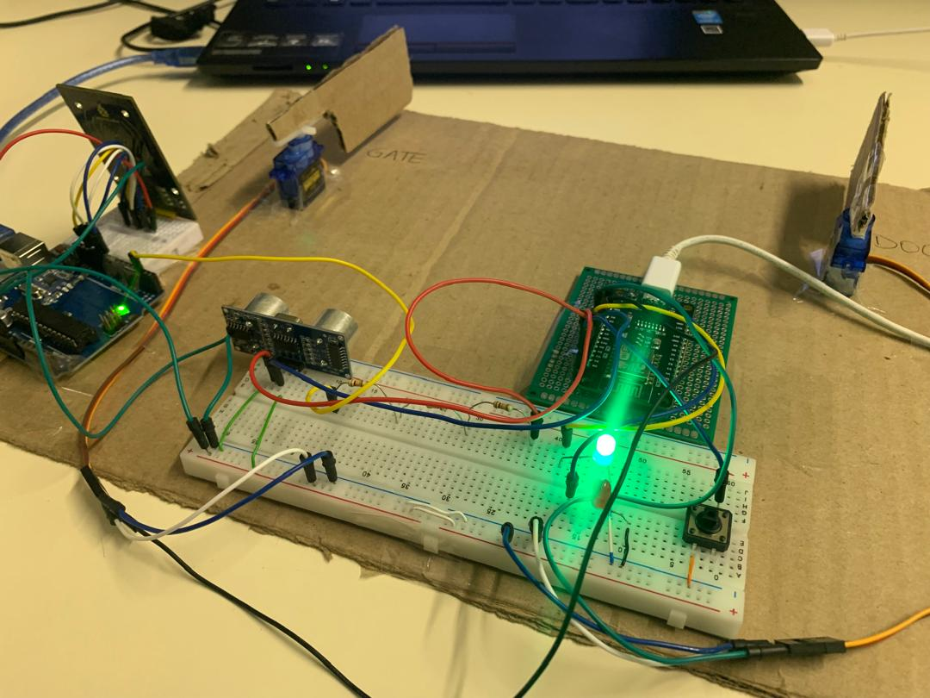
Agenda
Introduction
Goals & Objectives
System Overview
Remote monitoring
SWOT analysis
Conclusion and Future Advancements

Slide 3
Introduction
The IoT Smart House Door Access System is a cutting-edge project designed to enhance home security through the integration of various sensors and control mechanisms with IoT based features.
The system is designed in a such a way that it locks down entirely both inside and outside whenever an intruder with a wrong access card tries to infiltrate the house.
The system can be override virtually using Blynk which gives the house owner full control over everyone that goes in and out of the house.

Slide 4
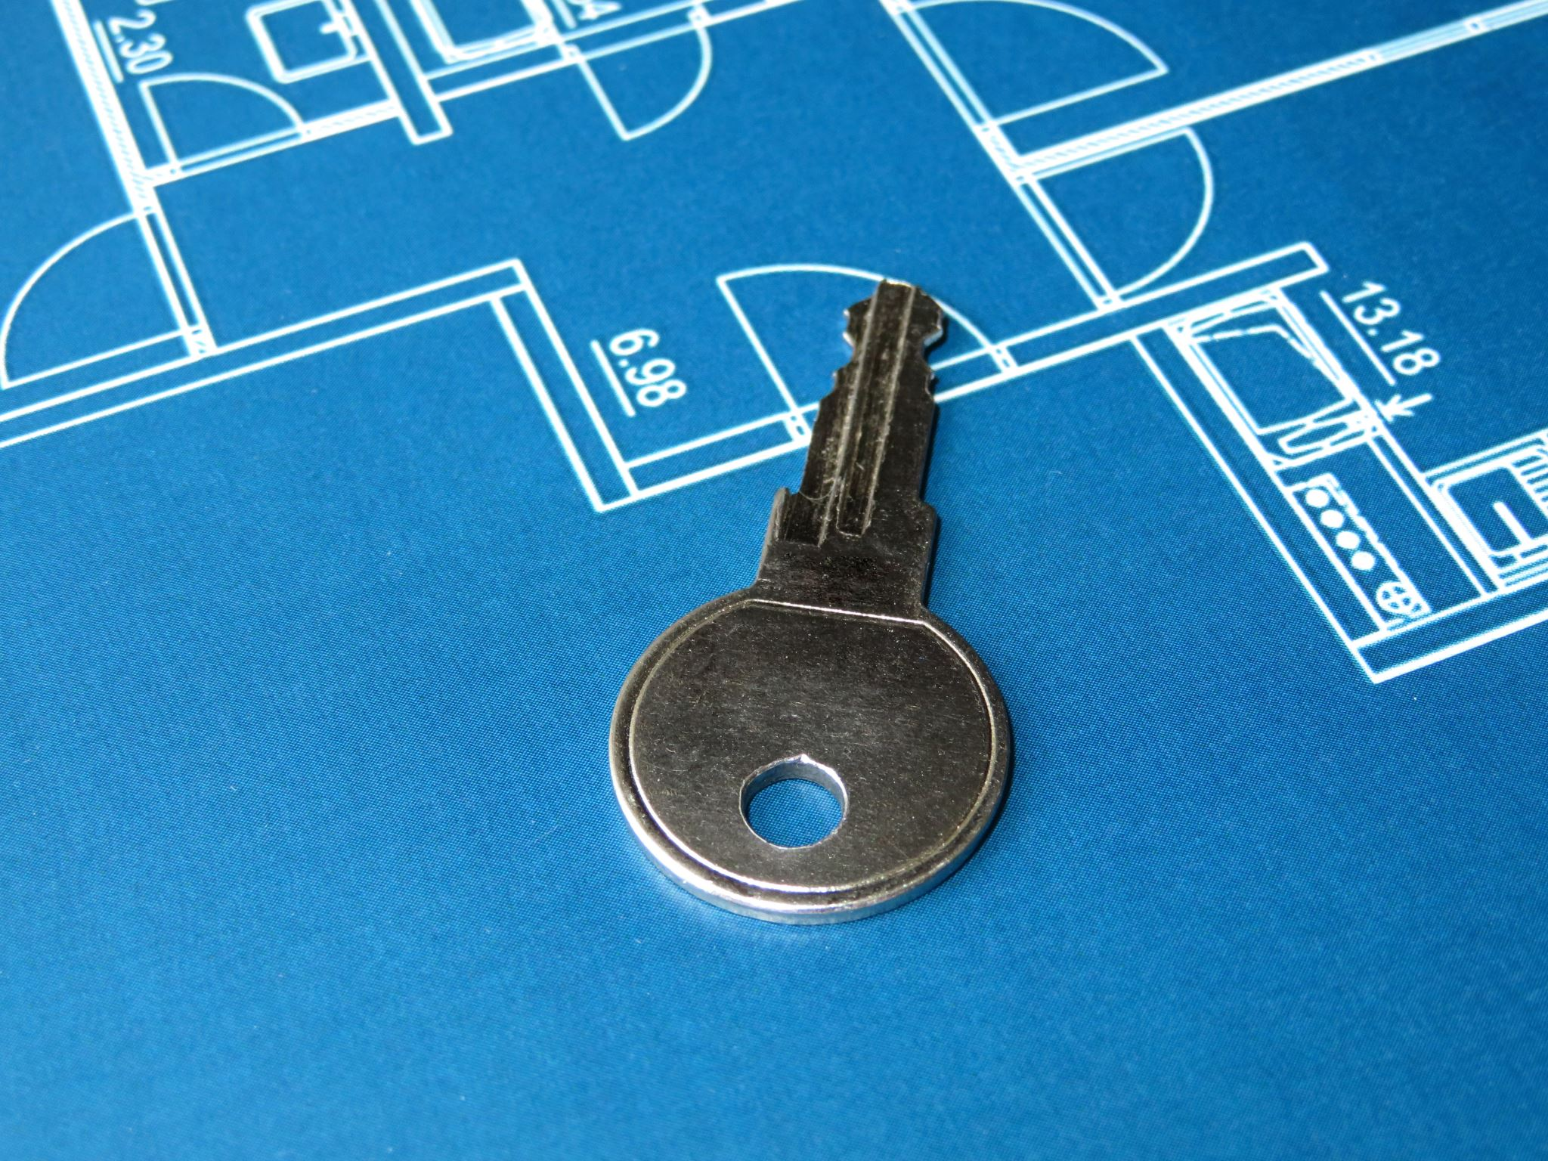
Goals and Objectives
Goals:
Enhance home security with a smart lock access system
Increase convenience with keyless entry
Provide remote monitoring and control capabilities
Objectives:
Integrate Arduino and ESP8266 for connectivity and control
Use an ultrasonic sensor to detect proximity and control door access
Implement Blynk application for remote access and monitoring
Include manual override with a push button for indoor operation
Display access status with virtual LEDs on the Blynk app

Slide 5
System Flowchart
Initialization:
Setup WiFi and Blynk connection
Initialize sensors and actuators
Waiting for Access:
Monitor access status from RFID/Access system
Access Granted:
Open gate and activate green LED
Measure distance with ultrasonic sensor
If person detected, open door
Manual Override:
Button press detected
Open door manually
Close Operations:
Reset system
Close gate and door
Activate red LED if access denied

Slide 6
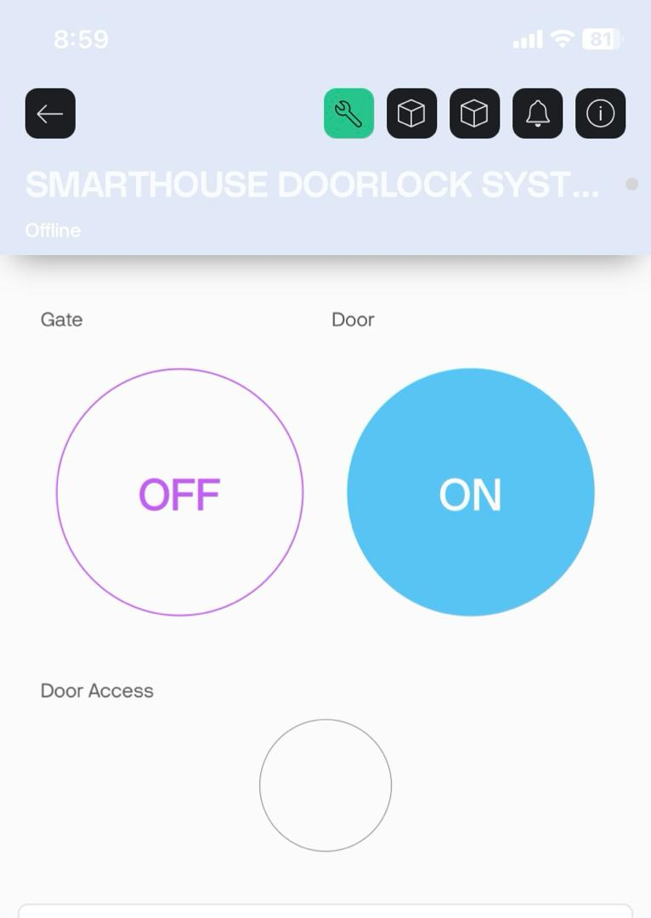
Remote Monitoring and Control
The ESP8266 module logs access attempts and provides remote control capabilities via a web interface.
This allows homeowners to monitor access logs and control the door remotely via BLYNK from anywhere.

Slide 7
SWOT ANALYSIS
Strengths
The availability of project components and good command of using an ESP8266
weakness
Unable to use keypad due lack of space on the Arduino digital pinouts
Opportunities
Make use of electronics lab bench setup to simulate and package prototype for demonstration
Threat
Time to fully test the prototype and rectify error if they arise my not be enough due to external factors

Slide 8
Conclusion
Benefits:
Enhanced security with remote monitoring
Convenience of keyless entry
Integration with smart home systems
Future Improvements:
Integration with camera for visual verification
Addition of fingerprint sensor for enhanced security

Slide 9
Thank you
Selma Velikoshi
220117926
Bachelor of Electronics and Telecommunication
NUST @2024

